Slide 1
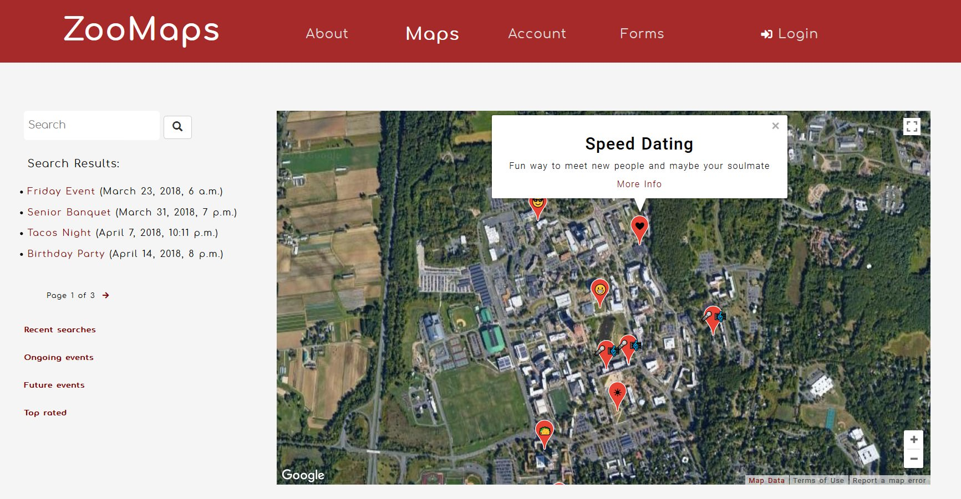
G-Tech: ZooMaps
Miles Black, Jordan Chen, James Curry, Mégane Michaud

